Slide 1


Understanding the availability of global biotic Hg data – and what to do with it all
David Evers
Biodiversity Research Institute – Executive Director and Chief Scientist
Global Mercury Partnership – Fate and Transport co-director
Global Mercury Assessment – Biotic Chapter lead author

Slide 2
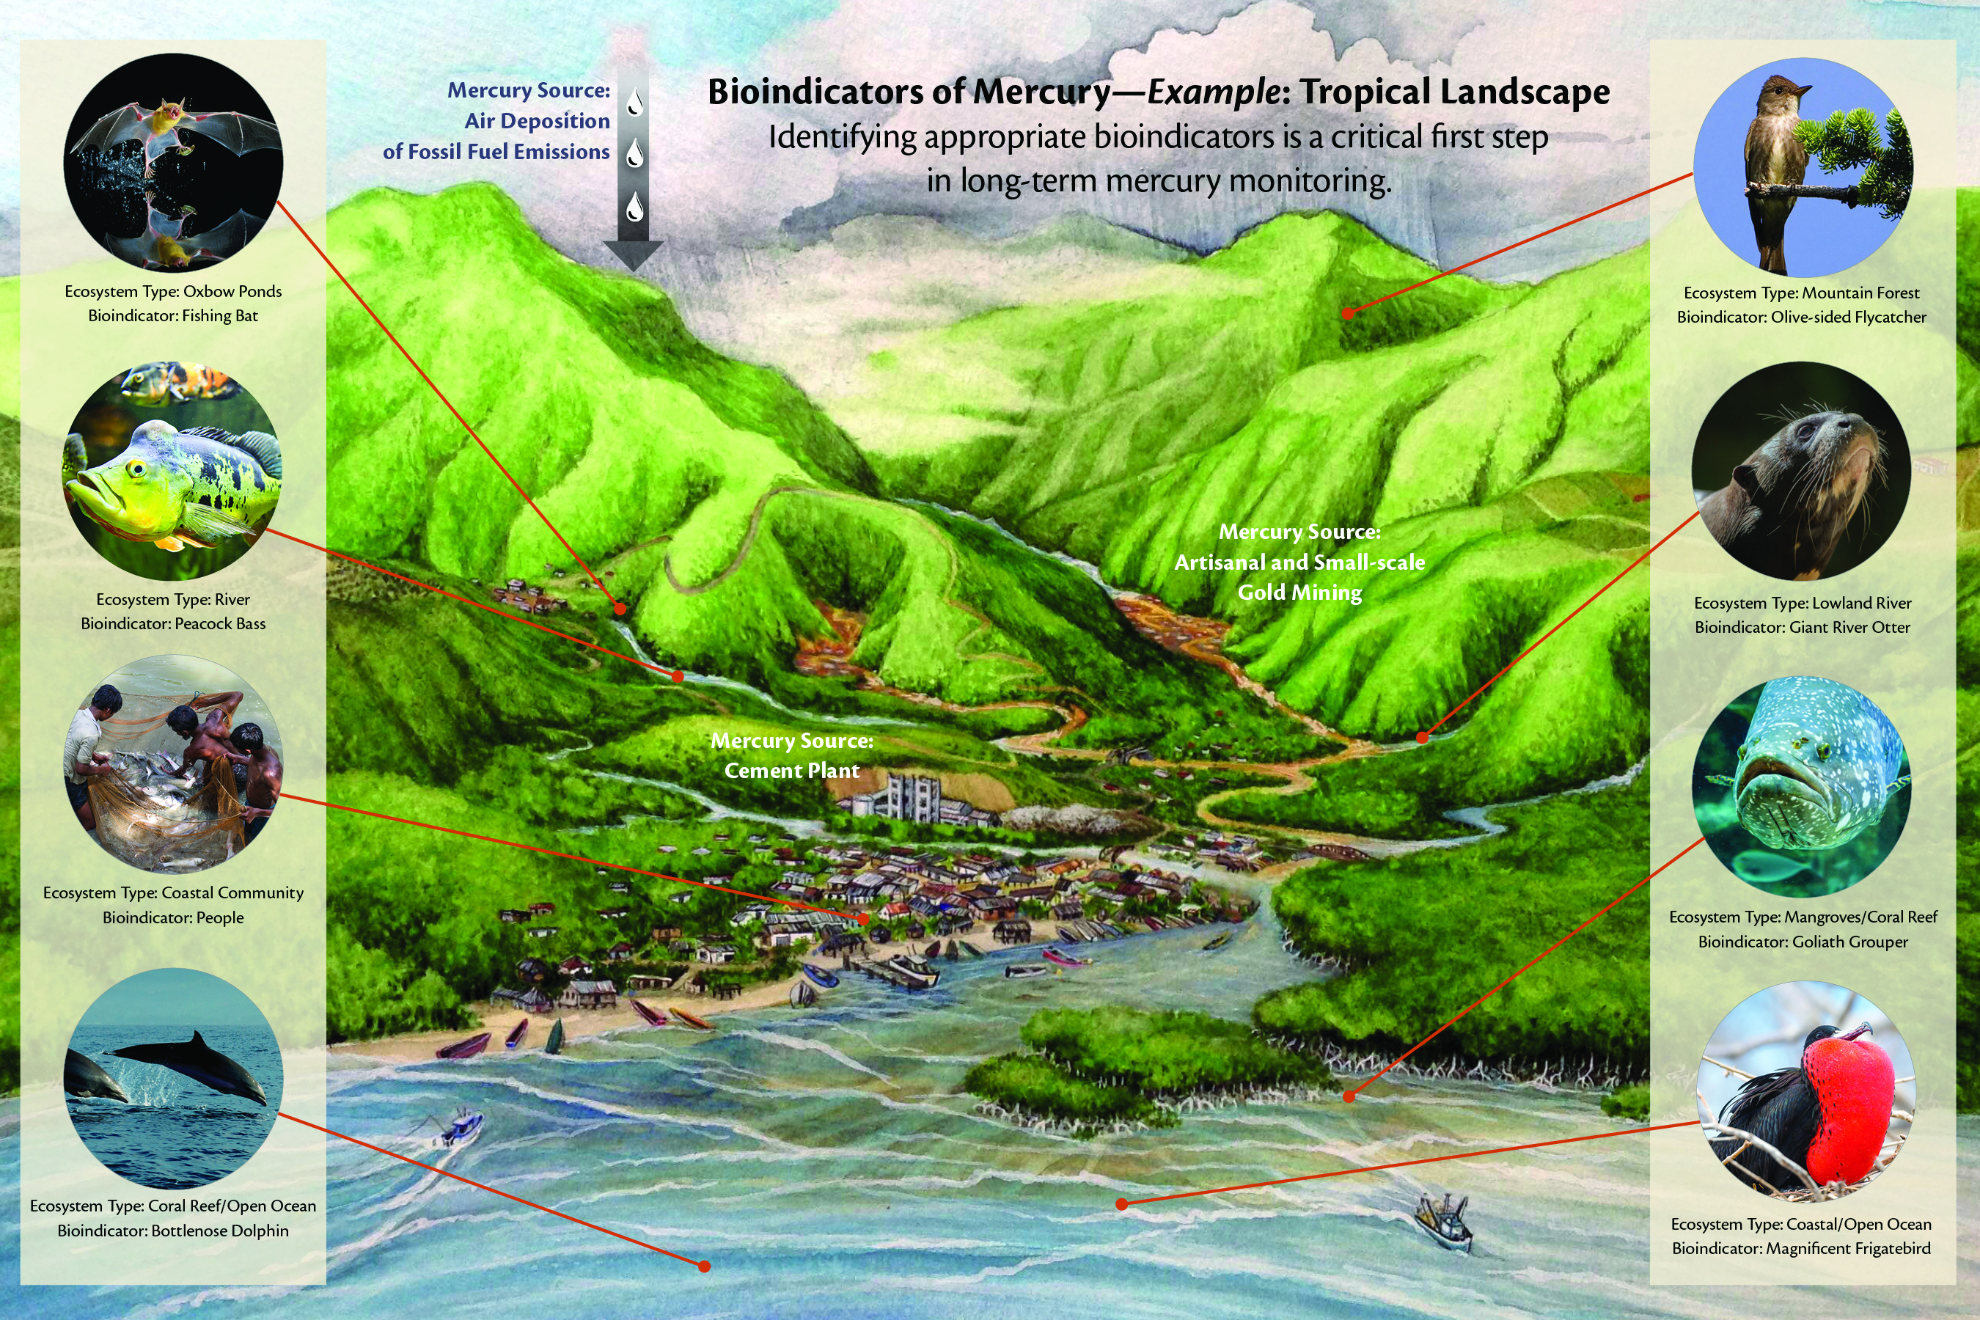

Slide 3
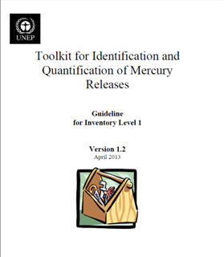
An approach toward global Hg biomonitoring
The UN Environment toolkit is used as a basis for Minamata Initial assessments in 105 countries around the world (2015 to 2019)
Biodiversity Research Institute is conducting or assisting with MIAs in around 40 of these countries (which provide helpful insight while developing pilot studies)
The Toolkit could serve as a template concept for biomonitoring
To conduct biomonitoring in a cost-effective and time-efficient way we need to identify the key inputs (i.e., variables) and outputs (e.g., biological Hg hotspots)

Slide 4
Key inputs and outputs needed toward biomonitoring: Caribbean Islands example
INPUT 1.
Overlay modeled and existing data of Hg released into air, water and land
- Use MIA findings from each country and UNE models
INPUT 2.
Overlay distribution of GIS wetland and hydrological layers and existing biotic Hg concentrations
- Use existing biotic Hg data (e.g., GBMS)
OUTPUTS
1. Map of areas of greatest risk/concern of biotic MeHg to:
a. Human health
b. Eco health
2. Prioritization of cost-effective biomonitoring
INPUT 3.
Overlay distribution of dietary items for people with known or modeled Hg concentrations
- Use WHO, FAO and other data for at-risk people
INPUT 4.
Overlay distribution of fish and wildlife of highest conservation and economic concern
- Use IUCN red-listed species

Slide 5
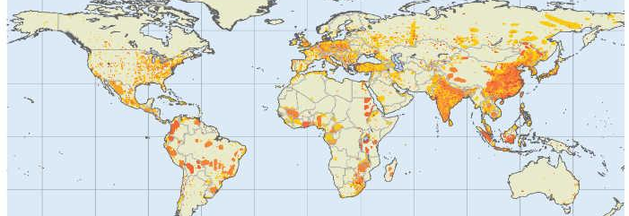
INPUT 1a – UN Environment Modeled Emissions and Releases data
New 2015 model released in 2018 as part of the new Global Mercury Assessment

Slide 6
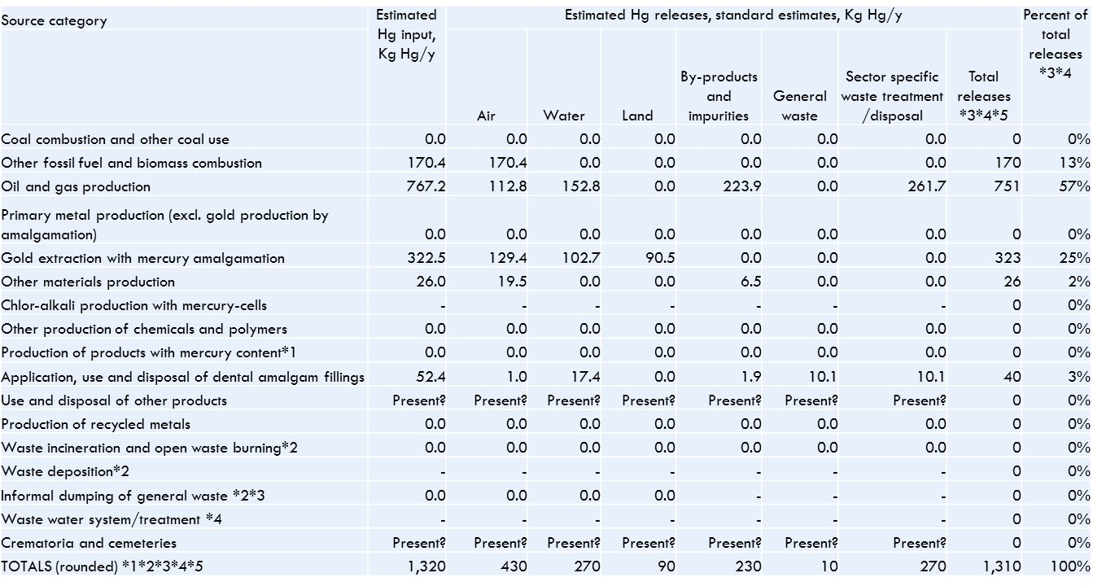
INPUT 1b – MIA Existing data
Over 100 countries conducting MIAs will have new Hg emission and release data for their country

Slide 7
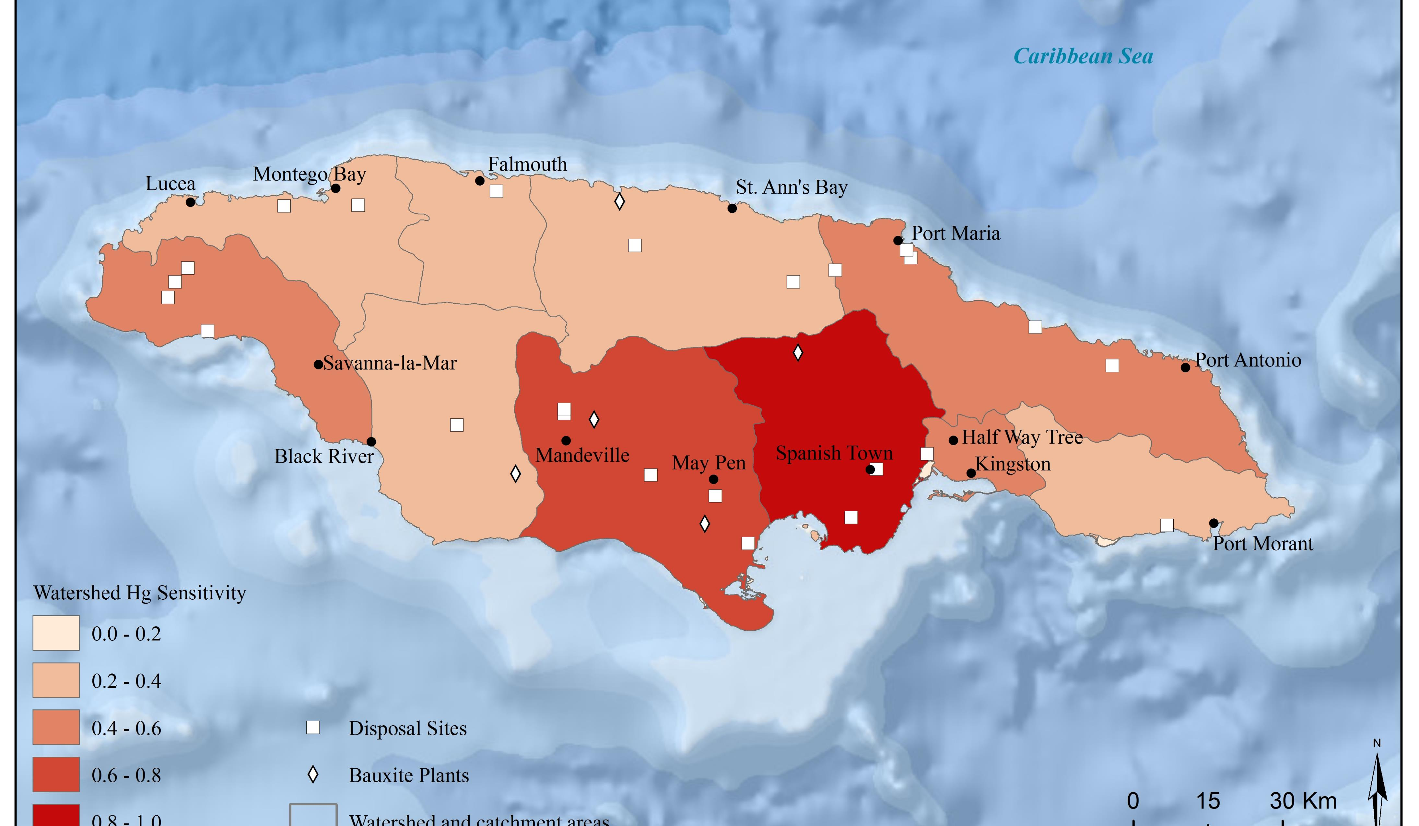
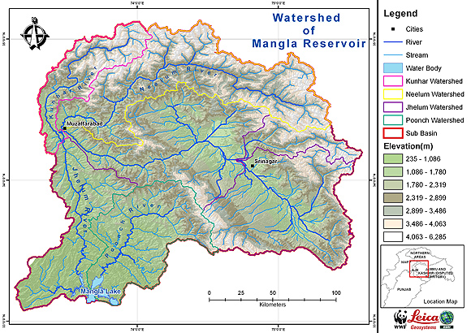
INPUT 2a – Existing Wetland and hydro GIS layers
Wetland and hydro GIS global-level layers are readily available at the resolution needed
Aquatic related habitats are key for ranking ecosystem sensitivity

Slide 8
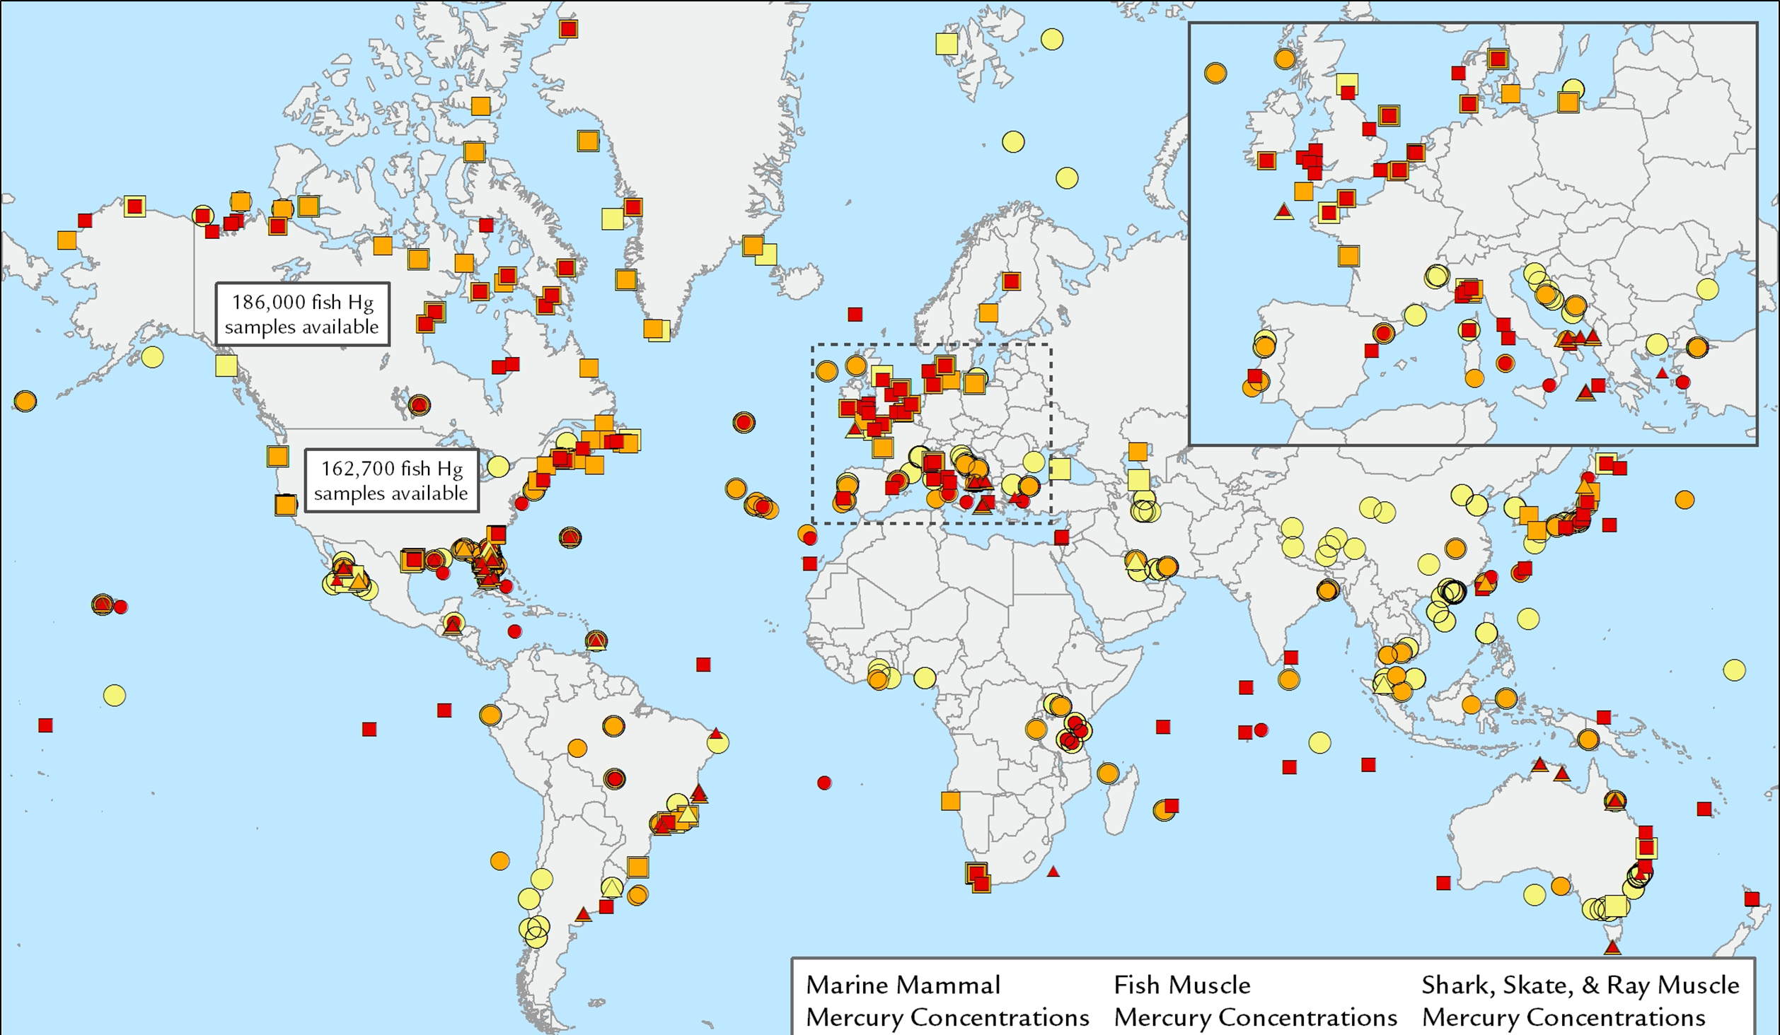
INPUT 2b – Existing biotic mercury data
The Global Biotic Mercury Synthesis (GBMS) database provides a complete series of peer-reviewed, published biotic Hg data available.
  Over 1,000 references
  Over 250,000 individuals
  Over 2,000 geographic points
Begin to see spatial and temporal patterns – but need to use the right bioindicators

Slide 9
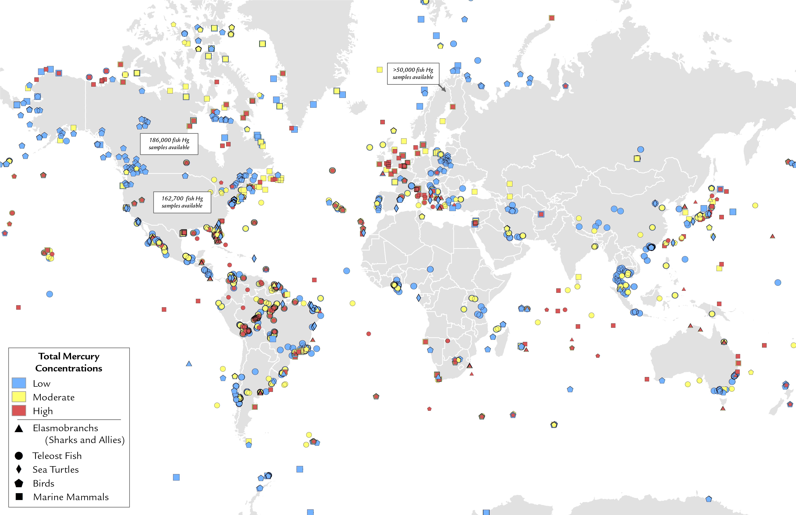
Biotic Hg concentrations (from peer-reviewed literature)

Slide 10
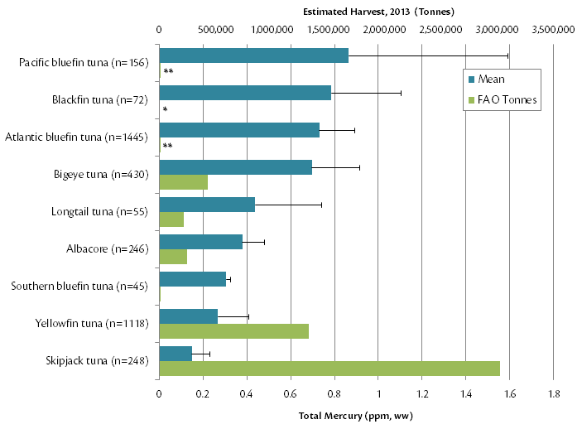
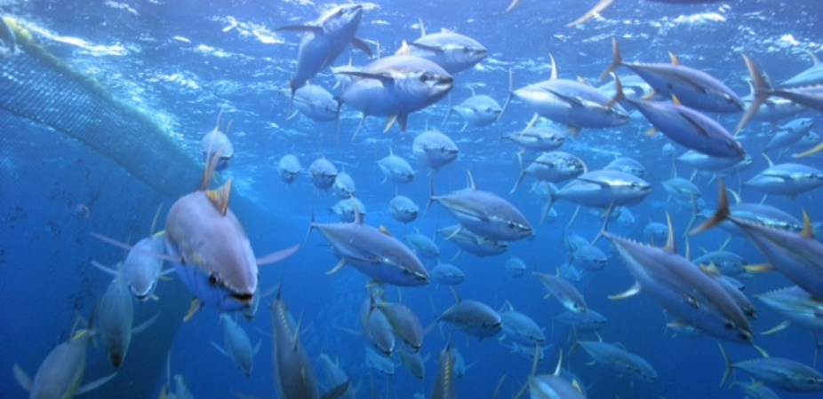
Tuna muscle total Hg concentrations (not adjusted for size of individual fish)
This Photo by Unknown Author is licensed under CC BY-ND

Slide 11
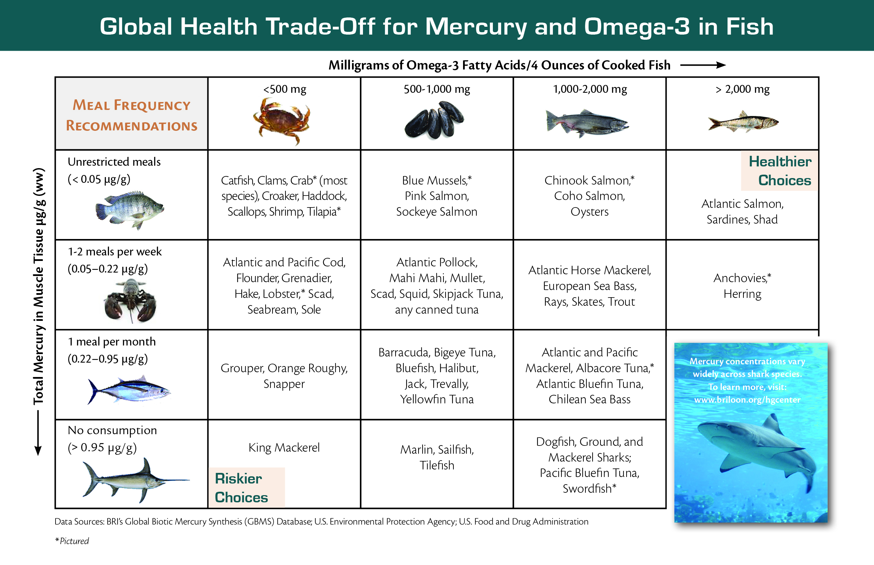
INPUT 3 – Human health related data
What are people eating?
Where are the food items coming from?
What communities are at greatest risk?
Are high risk sectors within a population being impacted?

Slide 12
Input 4 - bioindicators / Species of concern matrix
(published in STOTEN)
Target Terrestrial Biomes | Associated Aquatic Ecosystems | Ecological Health Bioindicators |  |  |  | Human and Ecological Health Bioindicators
 |  | Freshwater and Marine Fish | Freshwater Birds | Marine Birds | Marine Mammals & Sea Turtles | Freshwater Fish | Marine Fish | Marine Mammals
Arctic Tundra | Arctic Ocean and associated estuaries, lakes, rivers | Sticklebacks¹ (freshwater); Arctic Cod² Sculpin³ (marine) | Loons^{4,5} | Fulmars⁶ Murres⁶ | Polar Bears⁷ Seals⁸ | Arctic Char⁹ Arctic Grayling¹⁰ | Halibut¹¹ Cod¹¹ | Beluga^{12, 2} Narwhal^{12, 2}
Boreal Forest and Taiga | North Pacific and Atlantic Oceans and associated estuaries, lakes, rivers | Perch¹³ (freshwater); Mummichogs¹⁴ (marine) | Loons¹⁵ Eagles¹⁶ Osprey¹⁷ Songbirds¹⁸ (Warblers, Flycatchers, Blackbirds) | Osprey¹⁹ Petrels²⁰ | Mink^{21,22} Otter^{21,22} Seals²³ | Catfish¹¹ Pike¹⁰ Sauger¹⁰ Walleye¹⁰ | Flounder¹¹ Snapper¹¹ Tuna¹¹ | Pilot Whale²⁴
Temperate Broadleaf and Mixed Forest | North Pacific and Atlantic Oceans, Mediterranean and Caribbean Seas, and associated estuaries, lakes rivers | Perch¹³ (freshwater); Mummichogs¹⁴ Rockfish¹¹ Sticklebacks²⁵ (marine) | Loons⁴ Grebes^{5,26} Egrets²⁷ Herons²⁷ Osprey¹⁷ Terns²⁶ Songbirds¹⁸ (Warblers, Flycatchers,Wrens, Blackbirds, Sparrows) | Cormorants²⁸ Osprey^{5,19} Terns^{26,28} | Otter^{21,22} Sea Turtles²⁹ Seals²³ | Bass^{10,30,31} Bream¹¹ Mullet¹¹ Walleye³¹ | Barracuda¹¹ Mackerel¹¹ Mullet¹¹ Scabbard-fish¹¹ Sharks^{11,32} Tuna^{11,32}
Tropical Rainforest | South Pacific and South Atlantic and Indian Oceans and associated estuaries, lakes, rivers | Catfish²³ Piranha³⁴ Snook¹¹ (freshwater); Bay Snook^{11,34} (marine) | Egrets²⁷ Herons²⁷ Kingfishers³⁵ Songbirds³⁶ (Wrens, Thrushes, Flycatchers) | Albatrosses^{37,38} Noddy³⁹ Shearwaters³⁹ Terns³⁹ Tropicbirds³⁹ | Otter⁴⁰ Sea Turtles²⁹ Seals⁴¹ | Catfish¹¹ Snakehead¹¹ | Barracuda¹¹ Grouper⁴² Sharks^{43,44} Snapper¹¹ Swordfish^{11,45} Tuna^{11,45}

Slide 13
OUTPUT 1. Relationship among key variables of the environmental Hg issue:
(A) Hazard; (B) Exposure; and (C) Receptor.
A. HAZARD –
Variable 1
(Hg source and deposition)
B. EXPOSURE – Variable 2
(sensitivity of ecosystem)
C. RECEPTOR – Variable 2, 3 & 4
(biotic trophic level)
Biological Hg Hotspot (a geographic area where the environmental Hg concentrations are sufficient to be methylated at levels of significant biological concern for ecological and human health.
e.g., Tigerfish living in tropical river floodplains downstream from ASGM activities are likely high in Hg
OR
e.g., Croaker in bays of the Caribbean Sea fed by currents from the delta of the Orinico River with ASGM activities are likely high in Hg

Slide 14
HBM – awareness raising efforts
IPEN-BRI Phase 1
UNEP-IPEN-BRI Phase 2
BCRC-IPEN-BRI Phase 3
24 countries (2015-16)
Based on hair total Hg analyses from all adults (n=30/country)
NGOs worked with communities to gather hair samples
Focused on Hg contaminated sites
Fish Hg sampled gathered
Results published
26 countries (2017)
Emphasis on Indo-Pacific countries
Based on hair total Hg analyses from women 18-44 years (n=30/country)
NGOs worked with Ministries and communities to gather hair samples
~30 countries (2018)
Emphasis on SIDS
Based on hair total Hg analyses (n= 30/ country)
BCRC/NGOs will work with Ministries and communities to gather hair samples
Ethics reviews

Slide 15
Human hair mean Hg concentrations by region

Slide 16
% over 1ppm

Slide 17
Mean by Region w/ BRI data

Slide 18
Mean by country

Slide 19
% above 3 thresholds

Slide 20

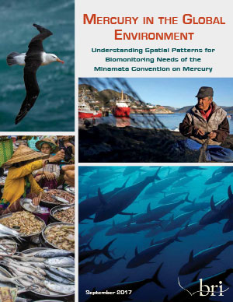
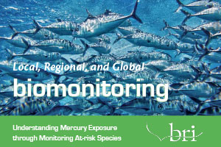
How to communicate needs to countries and their ministries

