Slide 1
LEAD IN PAINT ACTIVITIES AT UNEA 3
ACTIVITY | RESULTS
Meeting of Lead Paint Alliance Advisory Council & UN Environment Directors | Provided specific action points in the way forward with the Lead in Paint issue Regional Directors committed to eliminate lead paint and provided updated information/activities from their regions.
Science Policy Business Forum Session “The Case for Phasing Out Lead in Paint" | Panelists shared information regarding regulations for lead in paint, economic costs associated with lead poisoning, incentives to businesses, among others. 50 attendees.
Voluntary Commitments | Commitments made by Governments, businesses and CSO
Model Law and Guidance for Regulating Lead Paint | Raised awareness on Lead Paint Alliance resources Distributed hard and soft copies of resources to participants.
Sustainable Innovation Exhibit by Manufacturers of Lead Free Paint | Raised awareness on lead paint issue and alternatives available. Consumers interested in being informed of lead content in paints for decisión making. 80 visitors.
Blood Lead Testing | Blood lead levels taken from 2 populations: UNEA 3 participants and from a Motor Vehicle Industry.

Slide 2
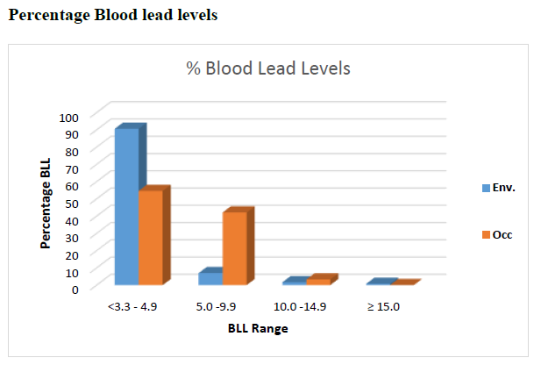
COMPARISON BETWEEN UNEA 3 AND INDUSTRY PARTICIPANTS
 | UNEA 3 | INDUSTRY (OCCUPATIONAL)
Participants | 299 | 183
Range | <3.3 – 15.6 µg/dL | <3.3 – 14.8 µg/dL
UNEA 3

Slide 3
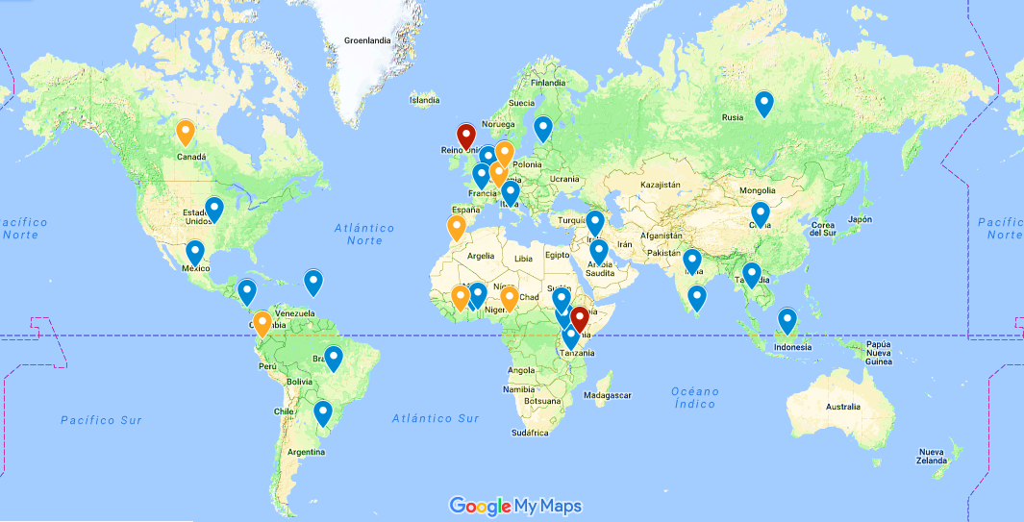
BLOOD LEAD TESTING AT UNEA 3
Blue: <5 µg/dL Orange: 5-9.9 µg/dL Red: 10+ µg/dL
Reference level at which CDC recommends public health actions be initiated 5µg/dL

